Slide 1
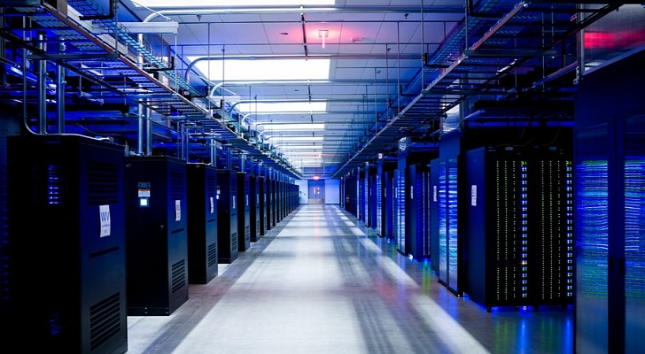

DL Workspace
Open Source Toolkit for Turn-Key AI Cluster (Introduction)
Notes:
This video introduces DL Workspace, an open source toolkit for turn-key AI Cluster setup and operation.

Slide 2
DL Workspace is …
Open source toolkit for turn-key AI cluster setup
Used for daily development/production in Microsoft internal groups (e.g., Microsoft Cognitive Services, SwiftKey, Bing Relevance)
Allow AI scientist to run jobs (interactive exploration, training, inferencing, data analytics)
Resource managed by cluster
Turn-key operation (automatic software setup & cluster configuration)
Out-of-box support
All major DL toolkits (TensorFlow, CNTK, Caffe, MxNet, etc..)
Big data analytics (Hadoop/Spark)
Notes:
DL Workspace provides out-of-box support for multiple Deep Learning toolkits, and big data analytical kits. It is used daily by Microsoft employees, and allows AI scientists to run both interactive and batch jobs on cluster.

Slide 3
WorkFlow
Notes:
The rest of the video explains the process to launch an interactive TensorFlow job.

Slide 4
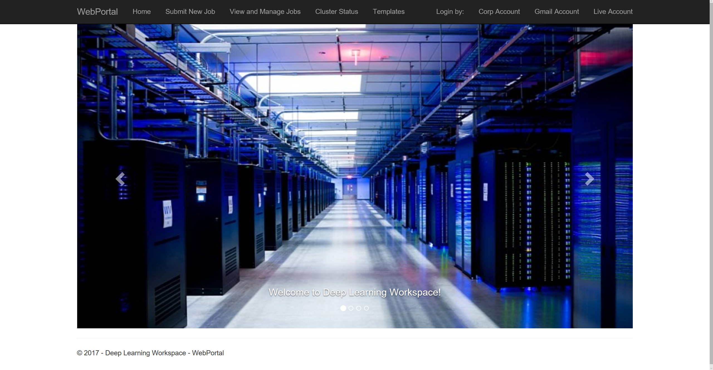
authentication via open id
Notes:
First, log in via your favorite provider through open id.

Slide 5
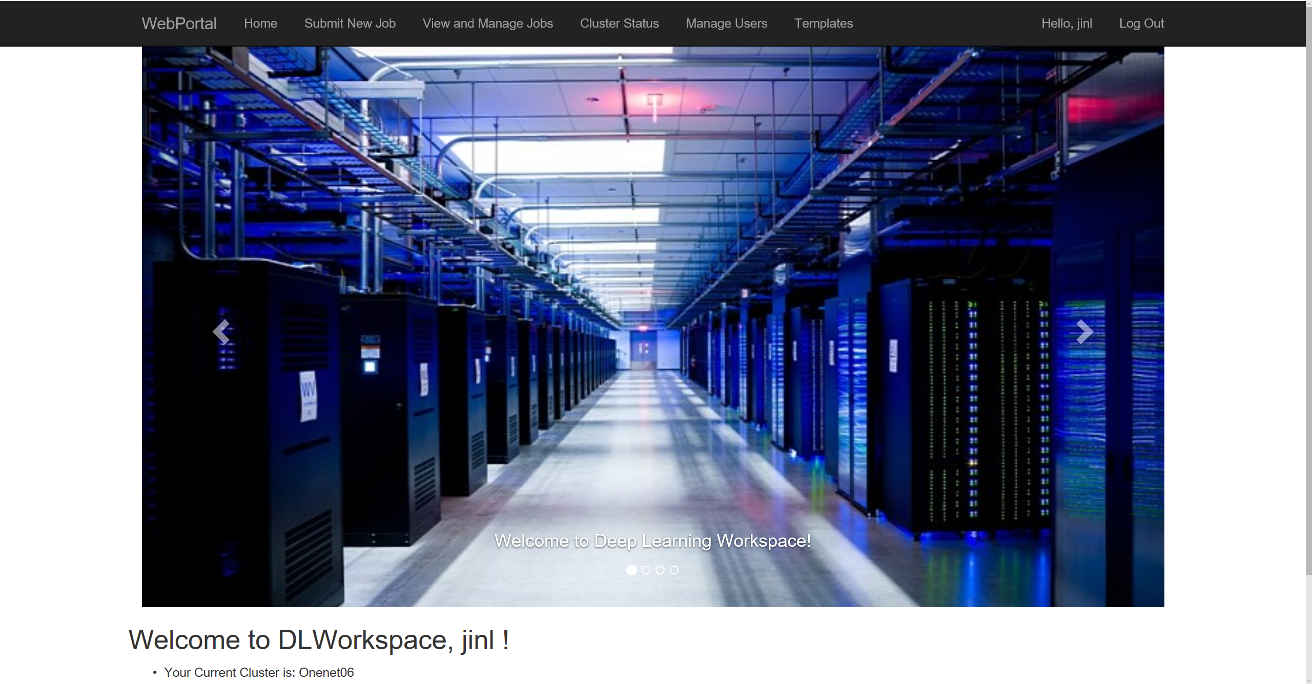
Select “Submit New Job”
once log in …
Notes:
Once log in, click “Submit New Job”

Slide 6
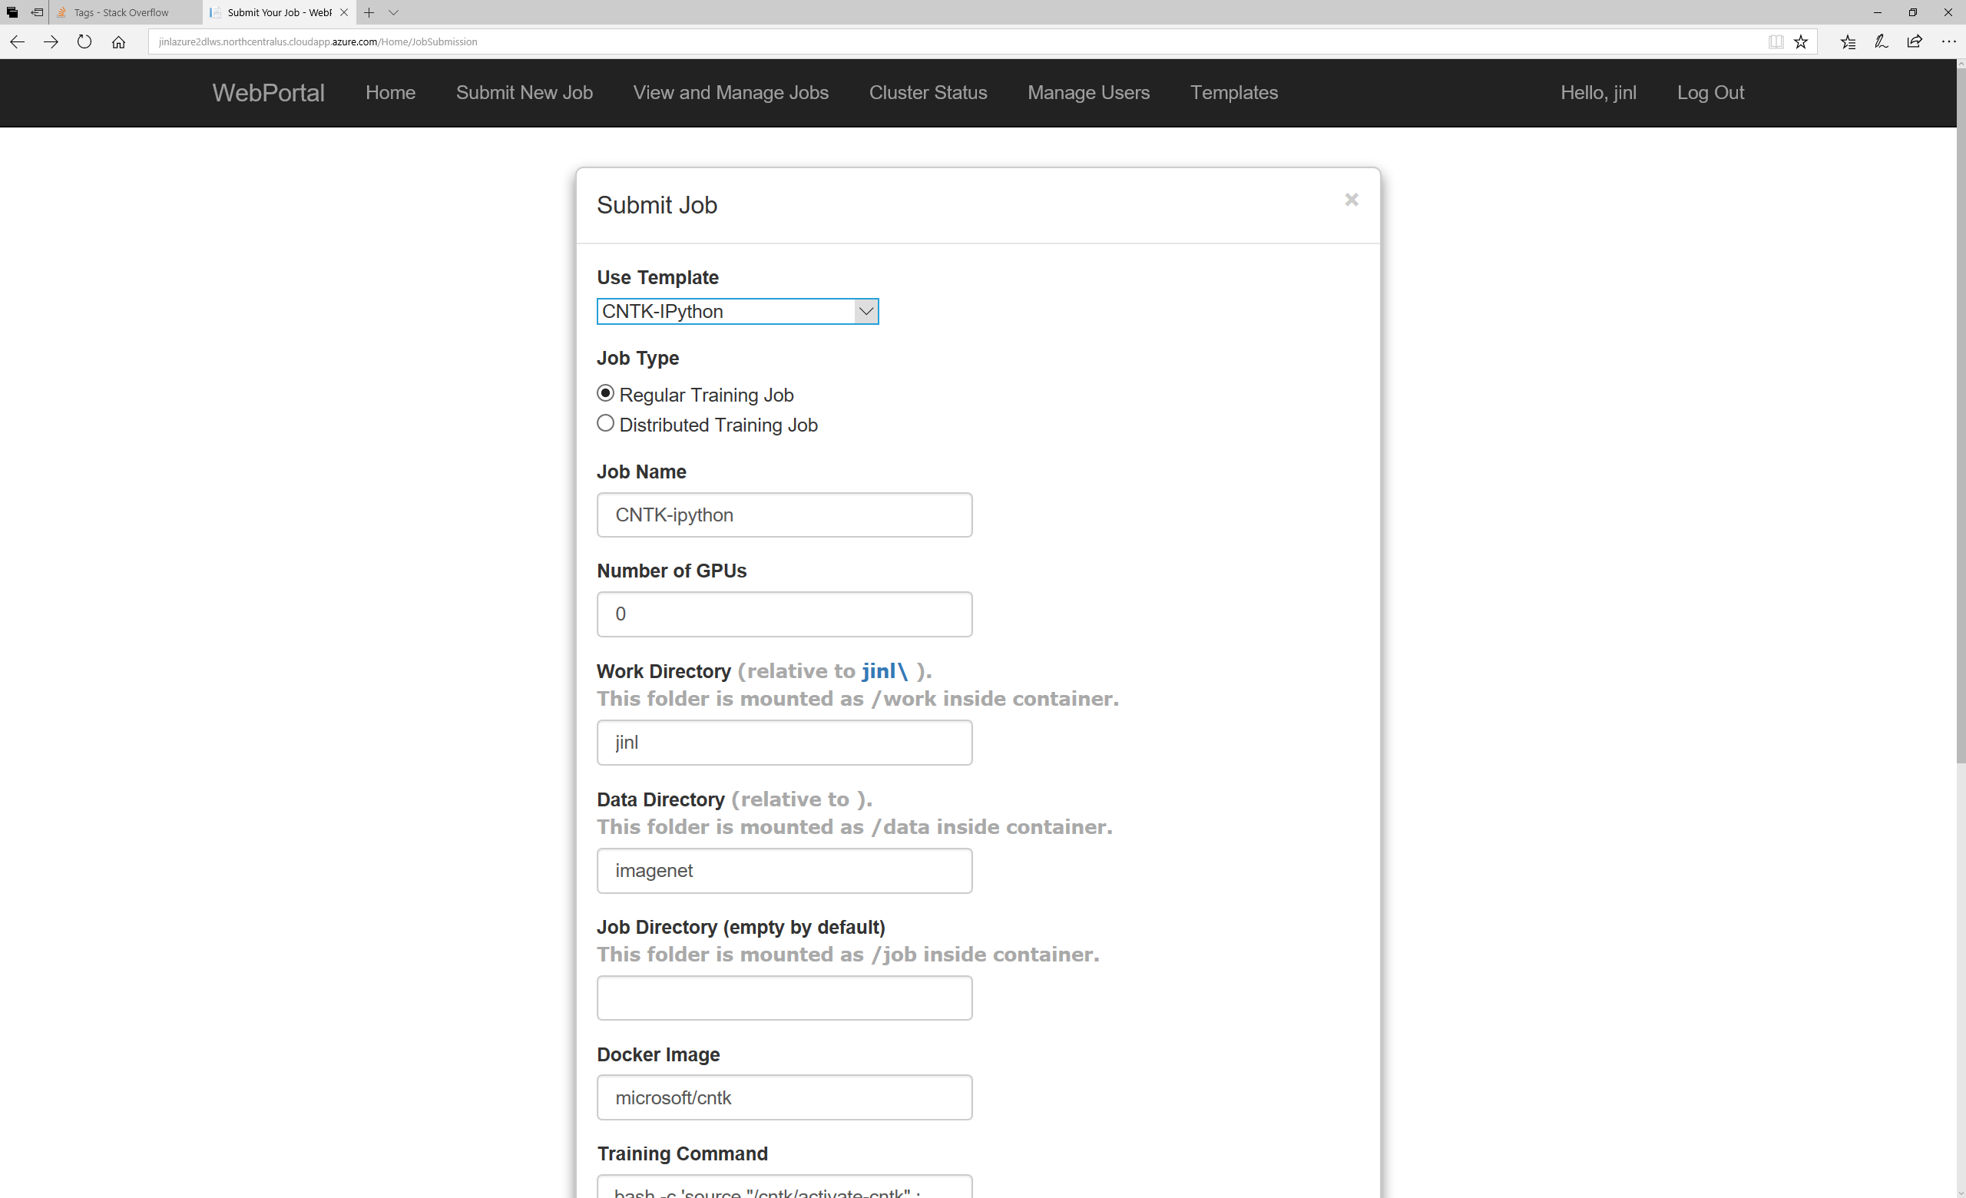
Select a template,
make optional modification
on job template
Notes:
Select a job template, and make optional adjustment.

Slide 7
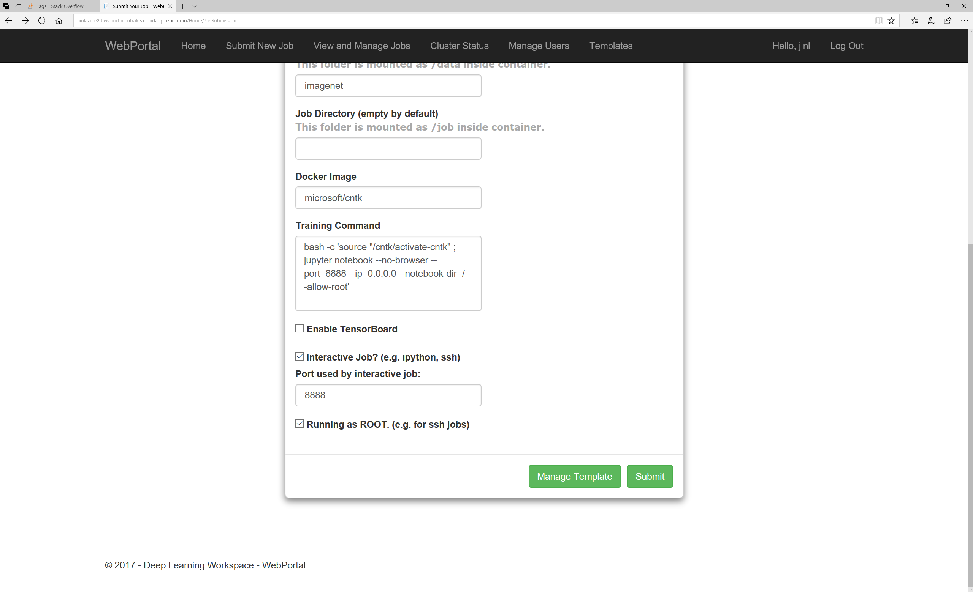
submit a job
Notes:
Click “Submit” button to schedule the job for execution.

Slide 8
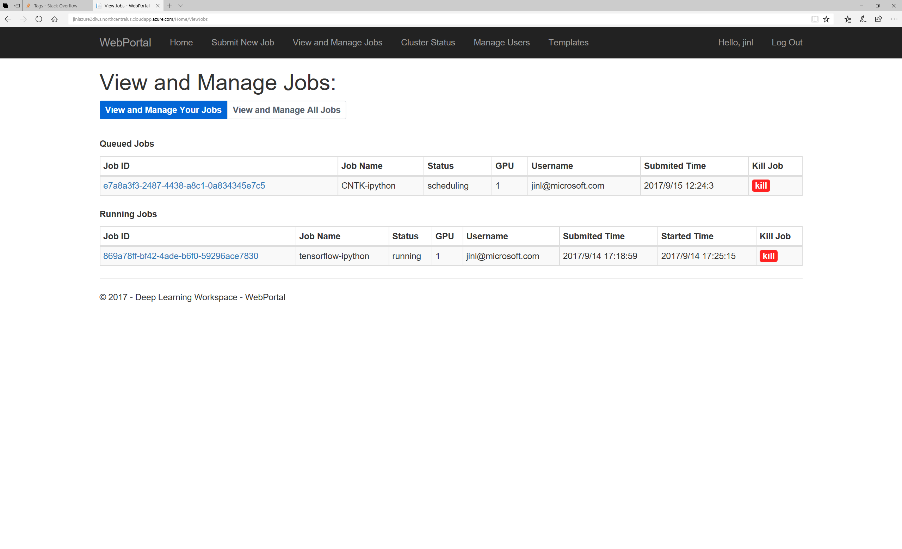
Select to view submitted jobs
Select Job ID
Notes:
Click “View and Manage Jobs”, and select proper job ID to monitor the jobs you have just executed.

Slide 9
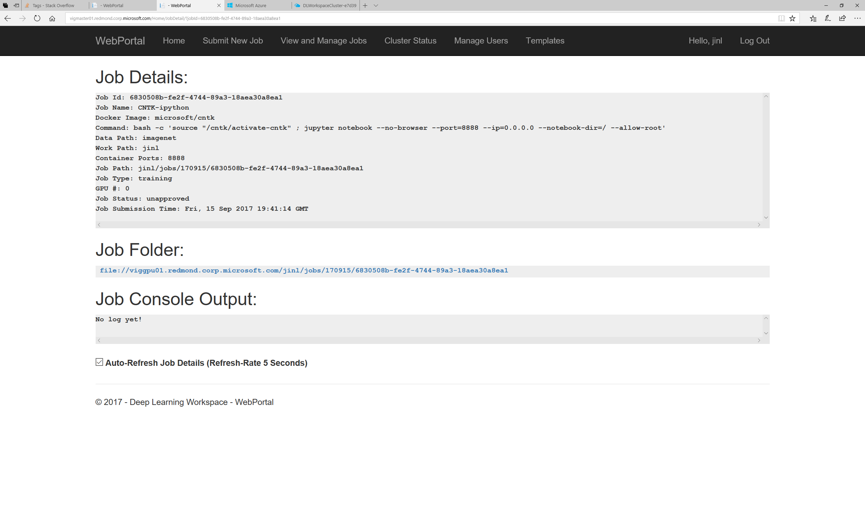
You may need to wait between a few seconds (execution of old job) to
several minutes (new job) for the job container to be scheduled, downloaded
and launched
Notes:
You may need to wait a few seconds to a few minutes for the job container to be scheduled, downloaded and launched.

Slide 10
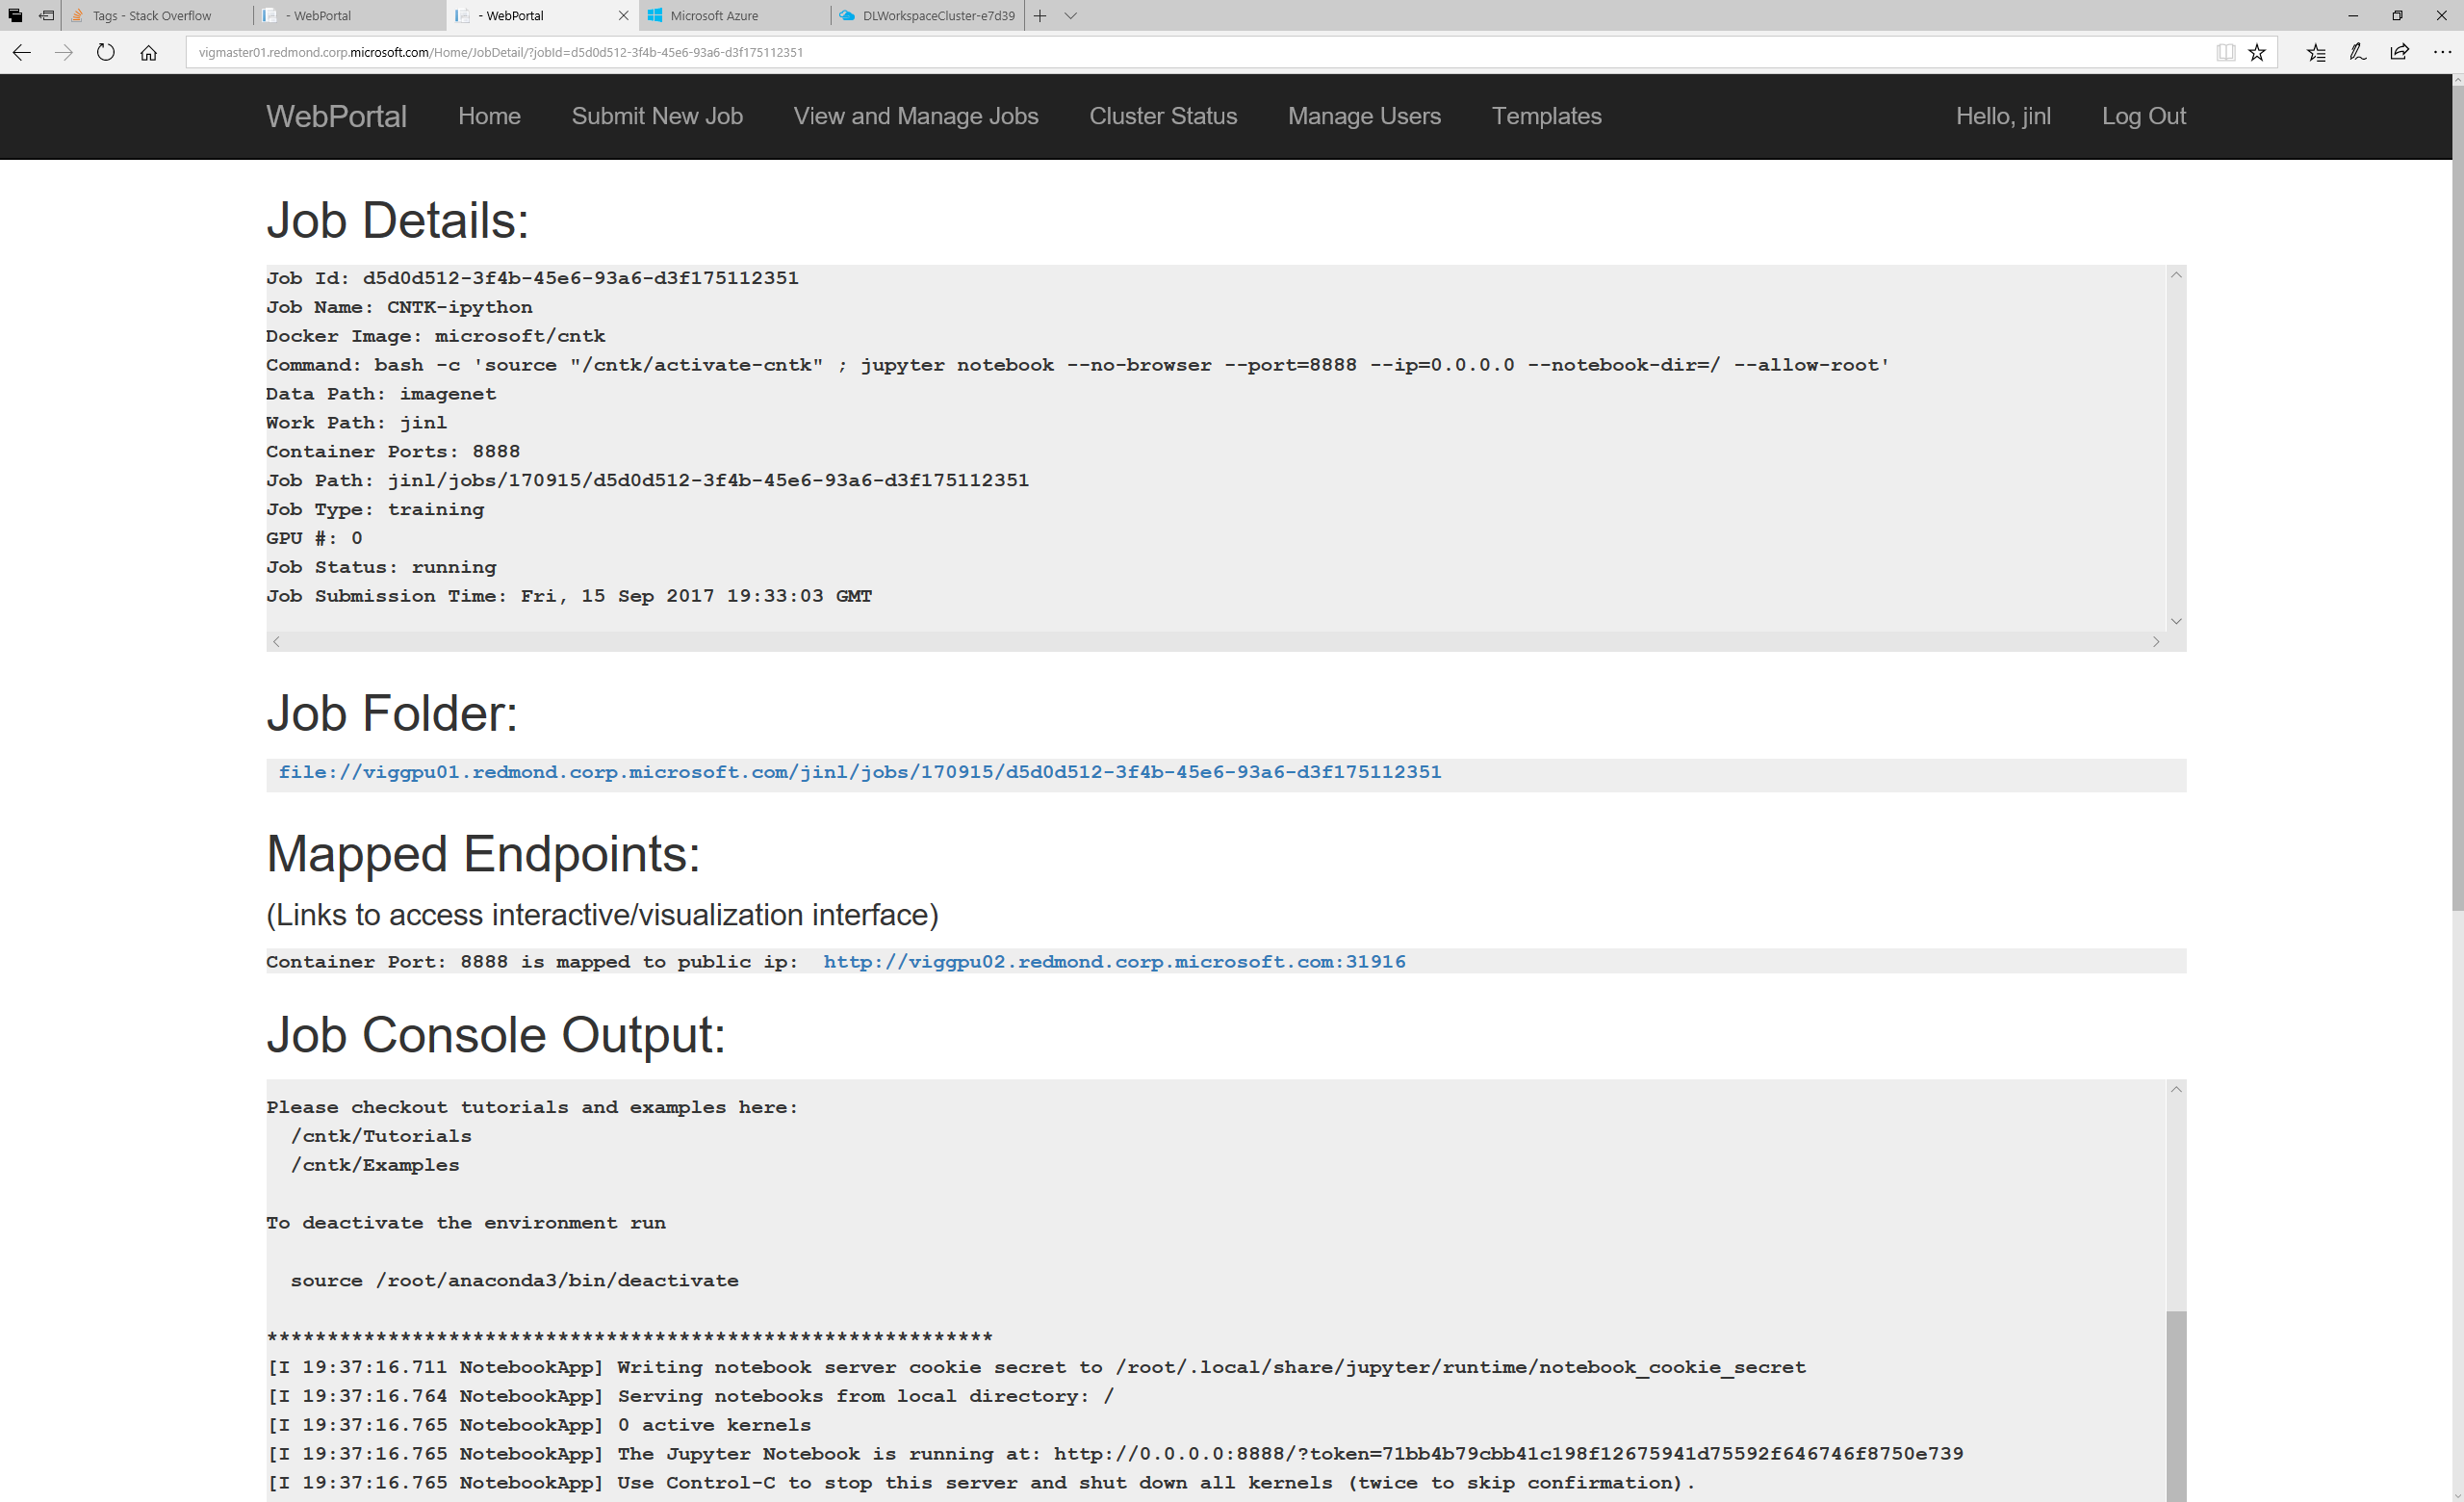
Wait for Mapped Endpoints to appear.
Notes:
Wait for “Mapped Endpoints” to appear.

Slide 11
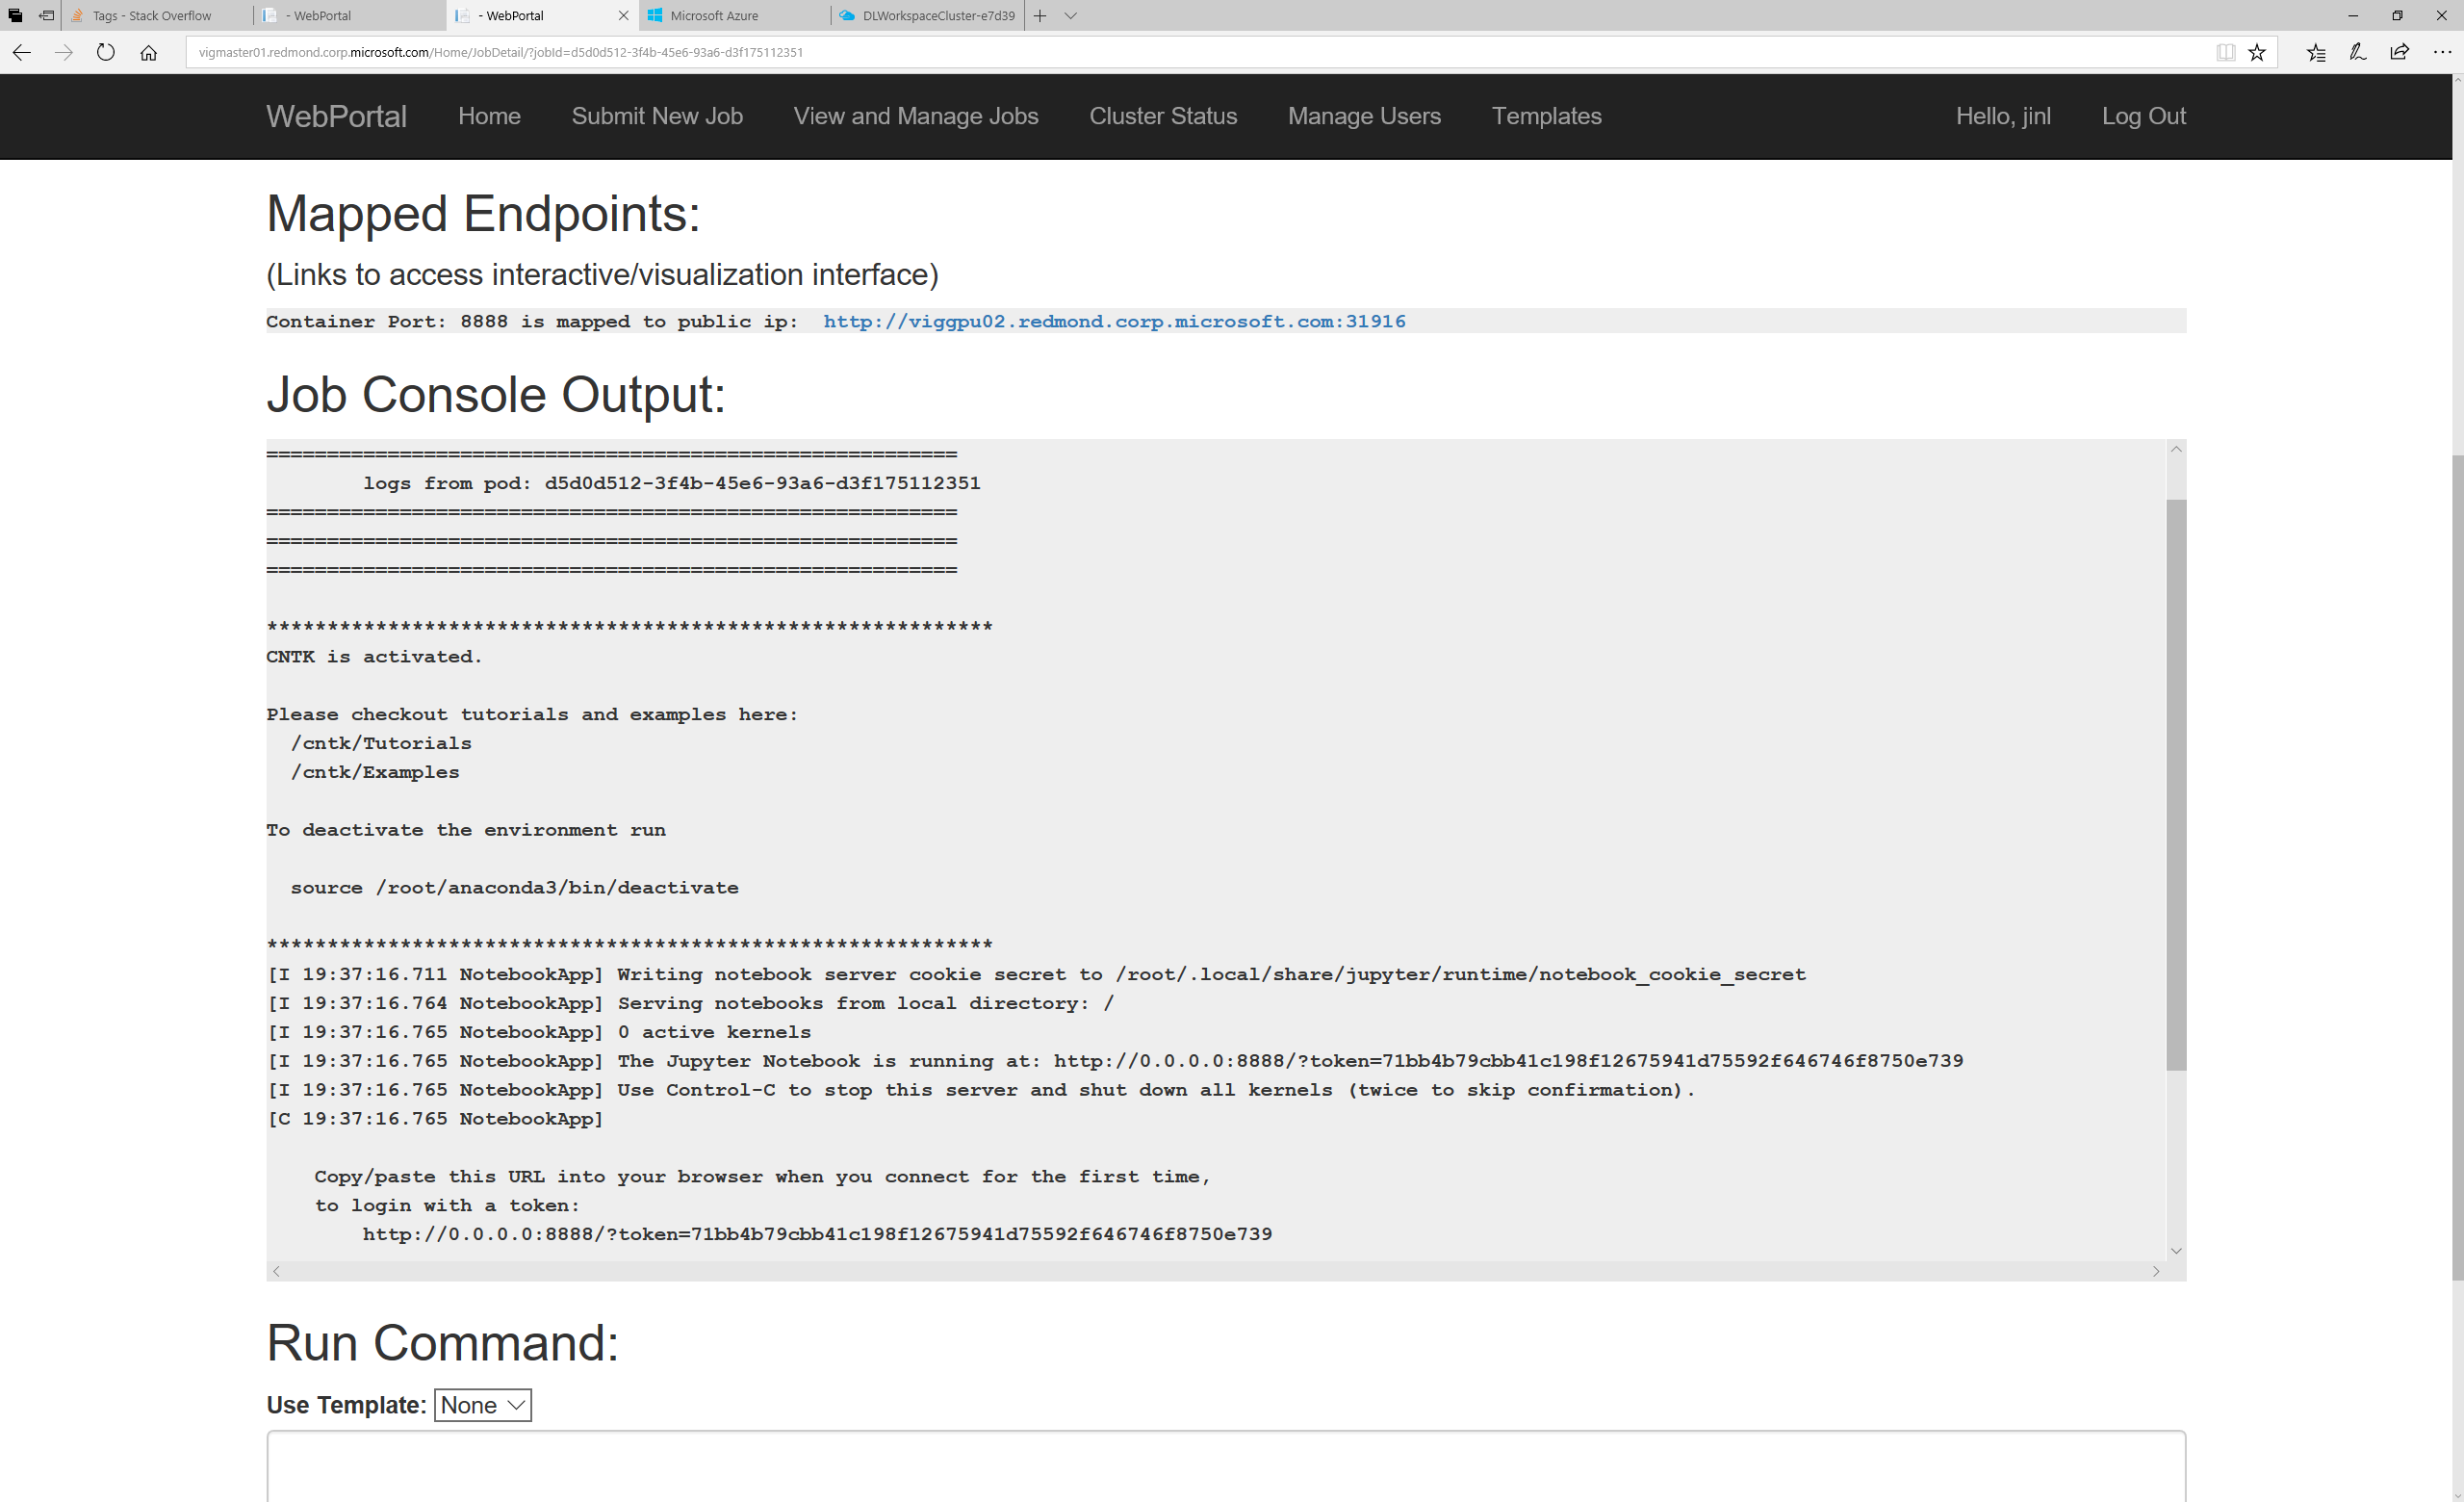
click endpoint link
For Jupyter notebook, copy security token
Notes:
Copy the security token for the Jupyter notebook,
and then click the Mapped Endpoint to access the job container.

Slide 12
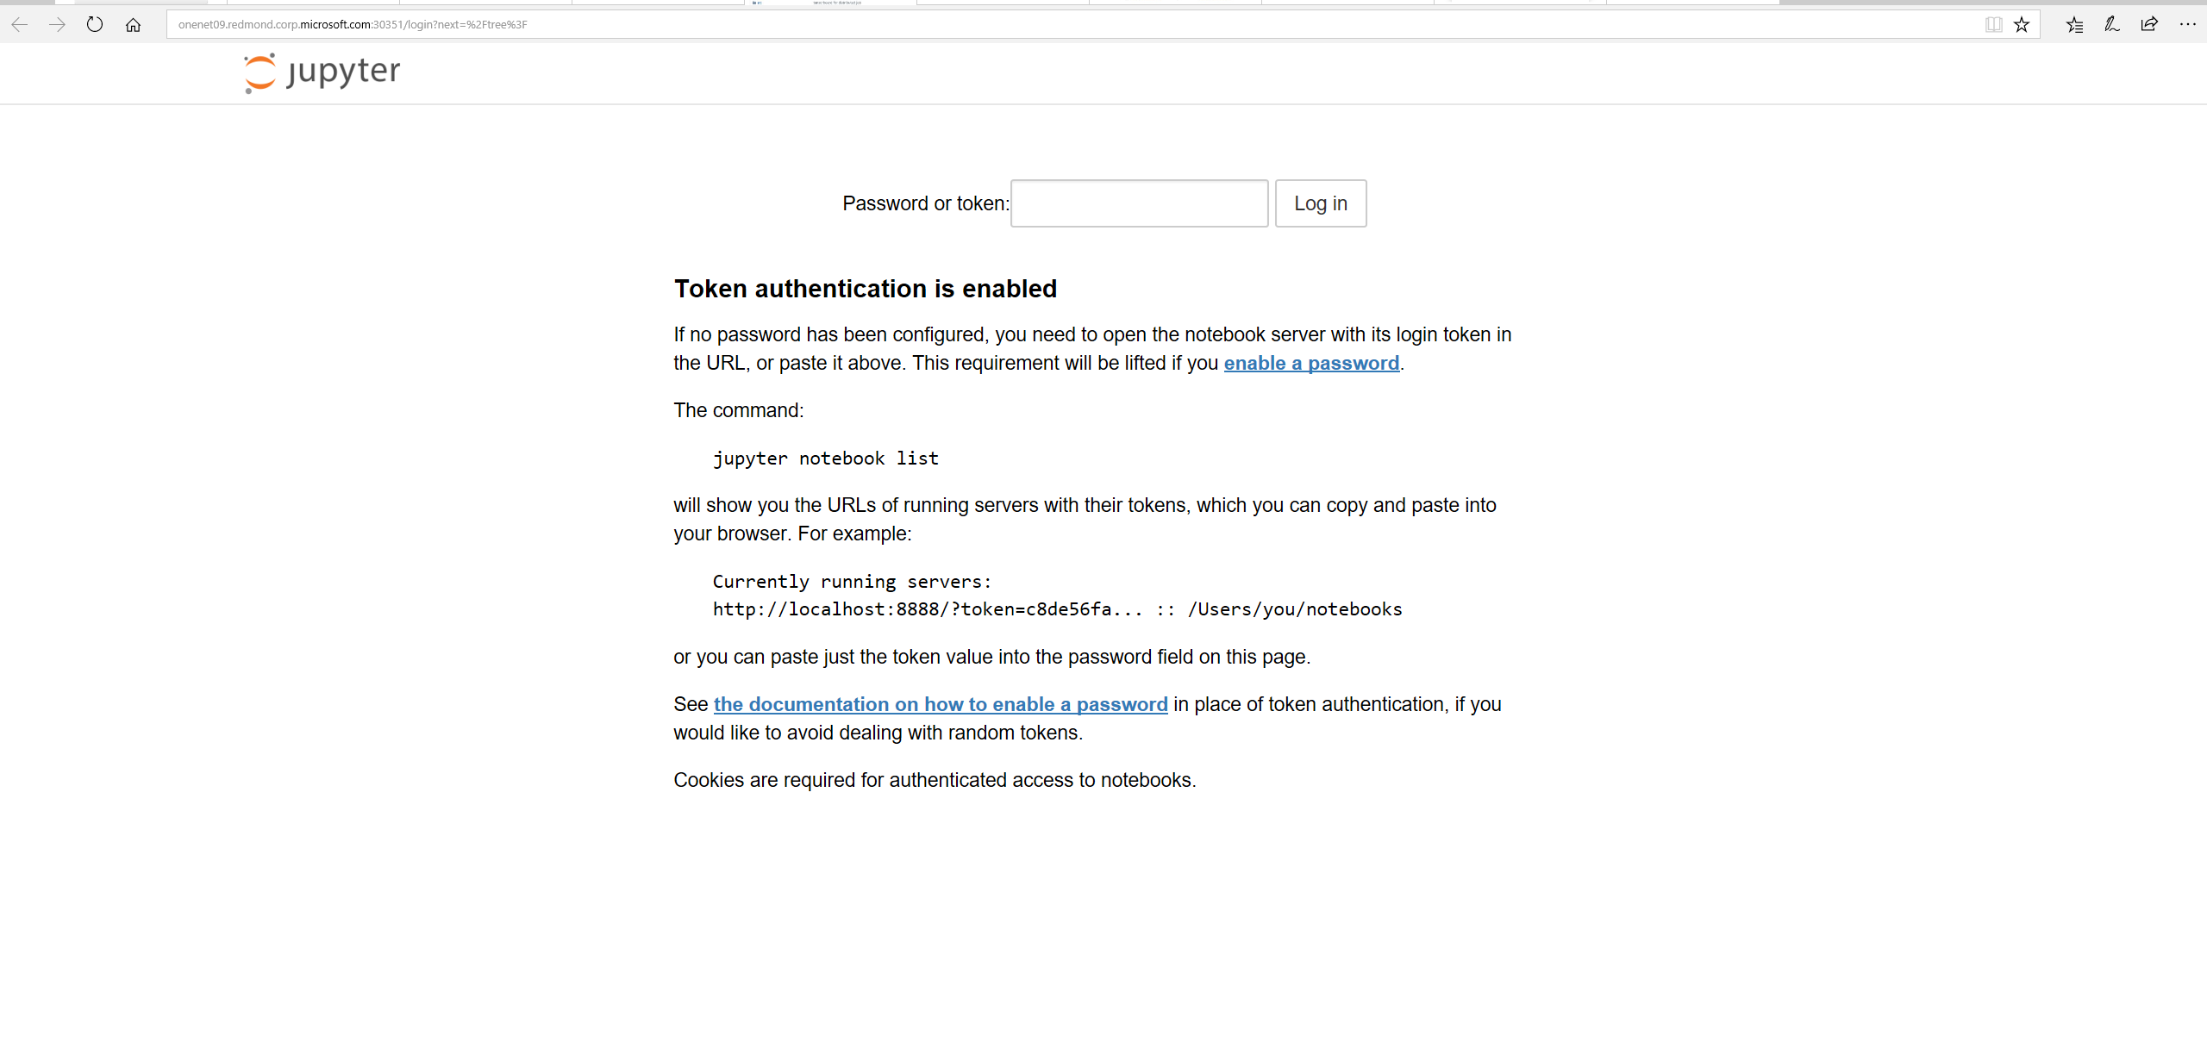
Paste security token, and click log in
Notes:
Paste the security token, and click “Log In”.

Slide 13
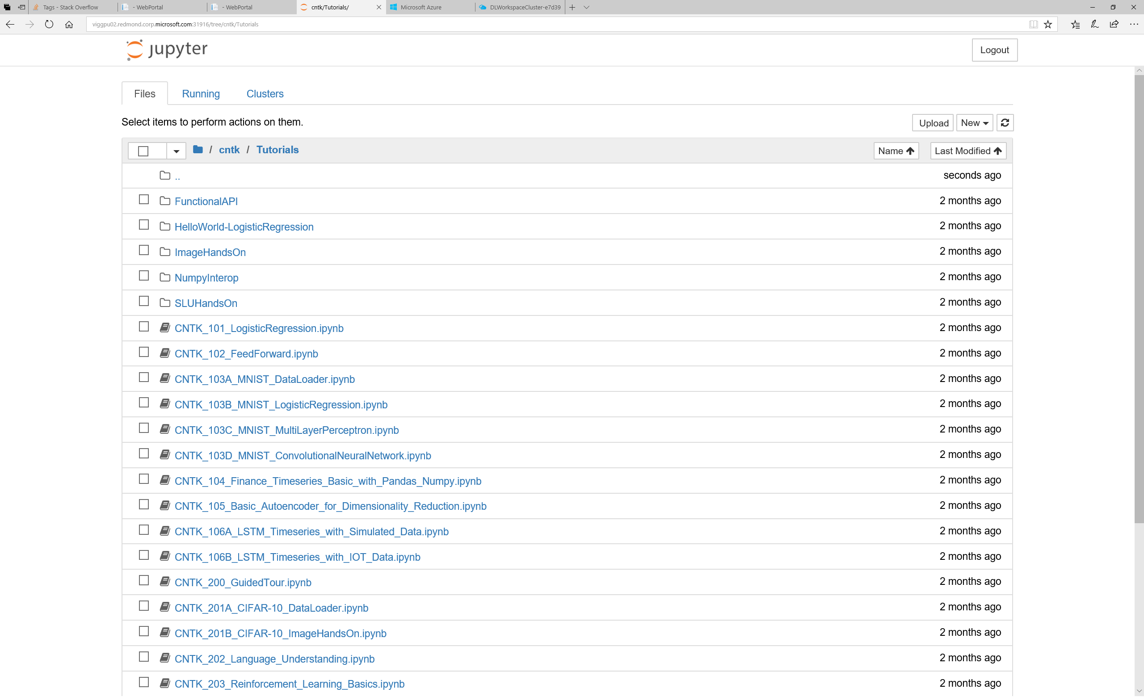
You now have access to a fully functional CNTK
container, with GPU resource (if requested).
You can click notebooks link
Notes:
You now have access to a fully functional TensorFlow container.
If requested, GPU resources will be
available and attached to the container. To access
TensorFlow tutorial, click the link “notebooks”.

Slide 14
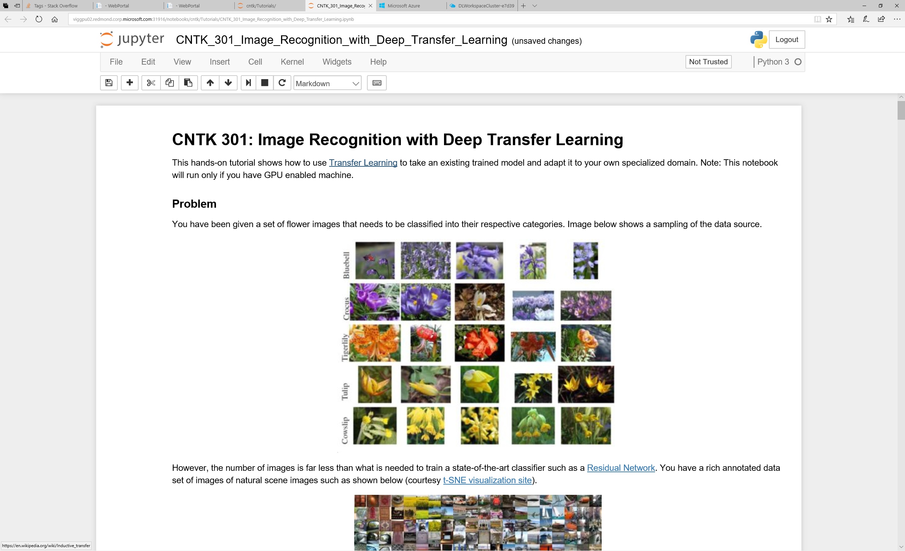
In this container, software (e.g., CNTK)
and hardware (GPU and its driver) are all pre-setup
Notes:
You are now in a Jupyter notebook, with both TensorFlow software and GPU hardware pre-setup.

Slide 15
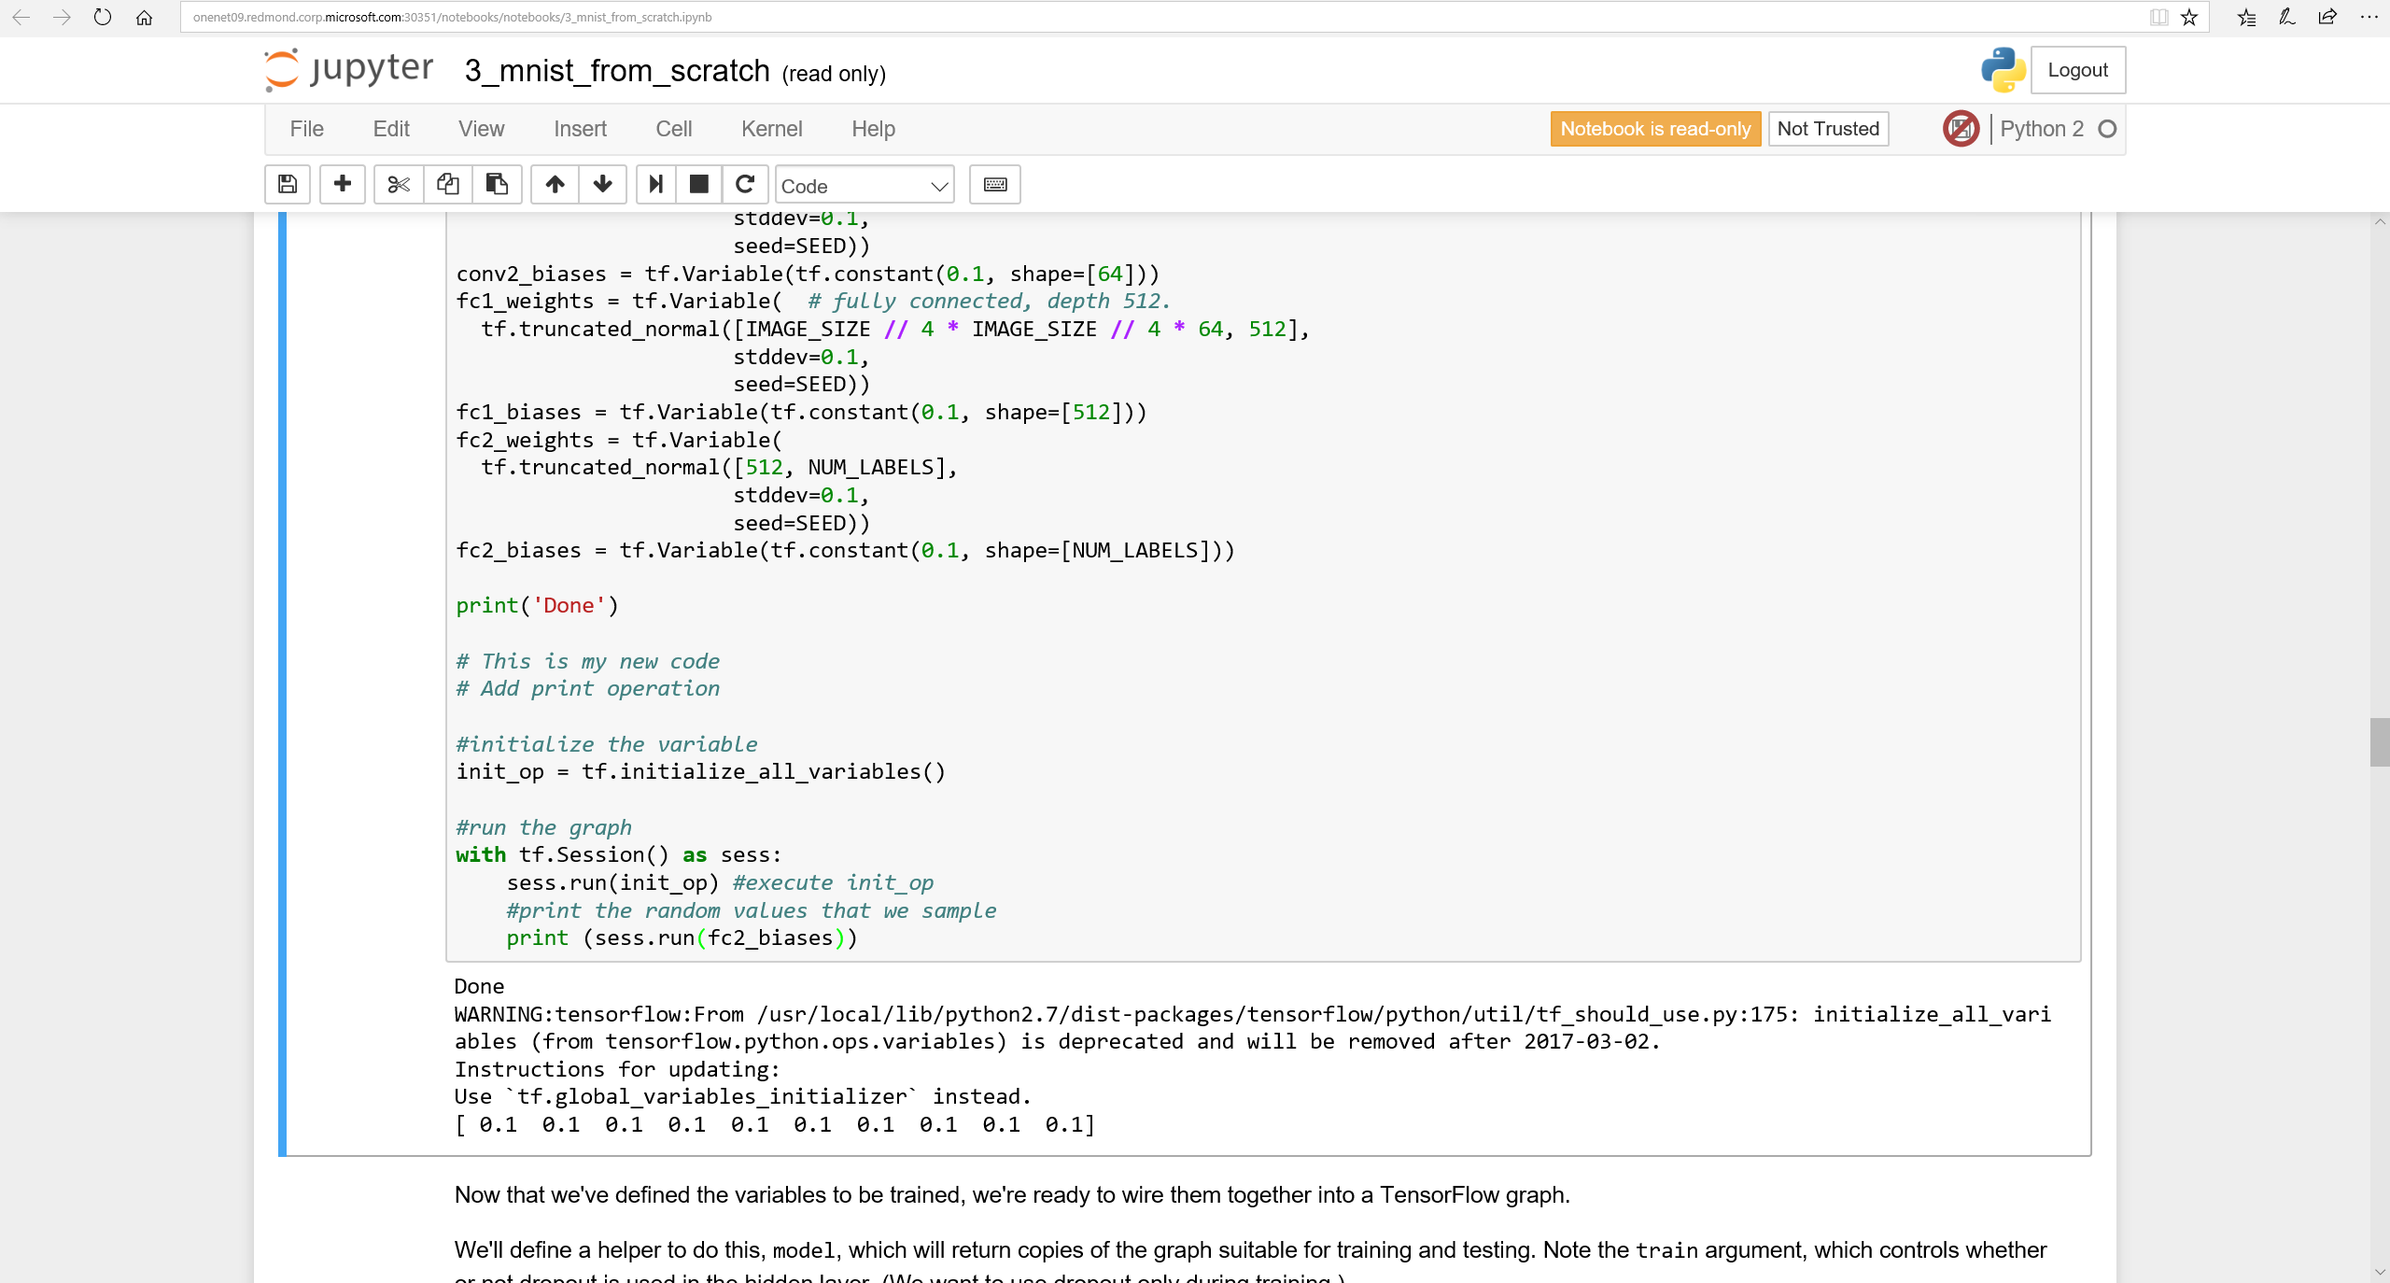
In this fully setup environment, you can write your own
program, execute the code, and interactively explore
AI models
Notes:
You can write your own program, execute the code, and interactively explore the inner working of DNN models.

Slide 16
DL Workspace provides …
Turn-key setup for AI cluster (in public cloud or on-perm)
Allow AI scientist to run jobs (interactive exploration, training, inferencing, data analytics) with fully setup software/hardware environment
Using DL Workspace, AI scientists can easily collaborate, and share job setup, and maximize job productivity
Notes:
DL Workspace provides turn-key setup for AI clusters,
allows AI scientists to jump directly to work, and
facilitates collaboration and sharing.

